Slide 1
EUREKA and Eurostars in Spain support services and funding, successful projects
Inmaculada Cabrera Hinojosa
EUREKA Spanish Office CDTI-E.P.E.
Inmaculada.cabrera@cdti.es
Prague, December 7th 2017

Slide 2
SPAIN IN EUREKA
How to cooperate with SPANISH companies
Conclusions

Slide 3
SPAIN IN EUREKA
What´s EUREKA?...… and what´s CDTI

Slide 4
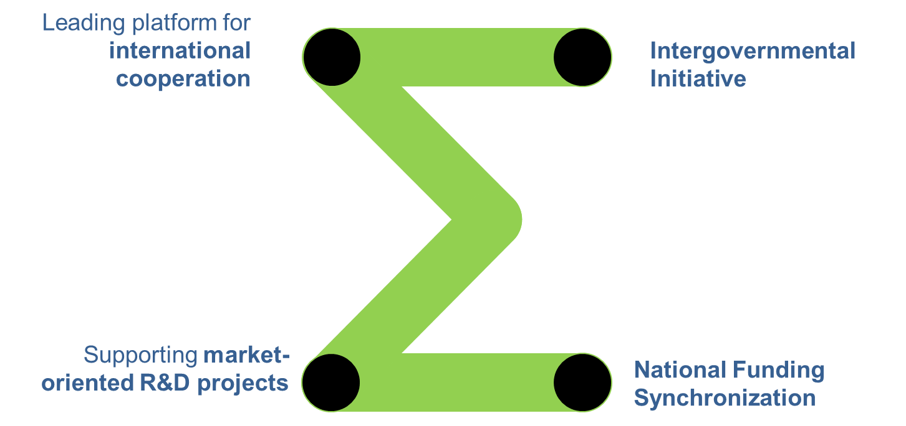
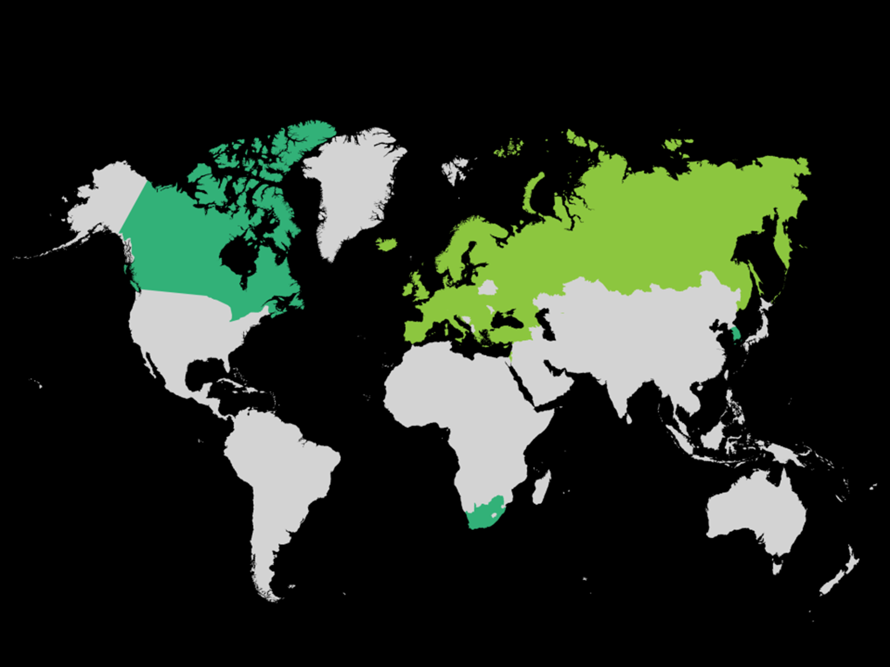
Leading platform for international cooperation
Intergovermental initiative (1985)
Supporting market-oriented R&D projects bottom-up
National funding Synchronization
Notes:
Los países comprometen financiación en mayor o menor medida en cada iniciativa
Convocatoria abierta permanentemente pero fechas definidas para la aprobación
Posibilidad de llamadas conjuntas a nivel bilateral o multilateral

Slide 5
Notes:
Los países comprometen financiación en mayor o menor medida en cada iniciativa
Convocatoria abierta permanentemente pero fechas definidas para la aprobación
Posibilidad de llamadas conjuntas a nivel bilateral o multilateral

Slide 6
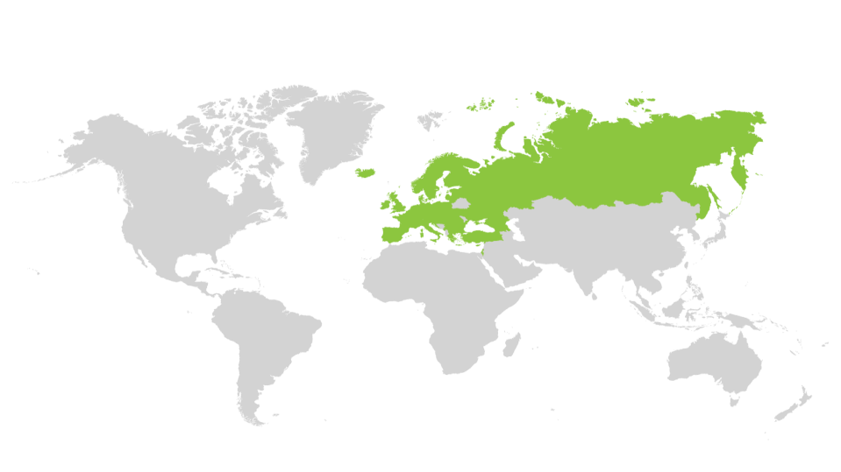
EUREKA members, 45 COUNTRIES to cooperate
Member countries
Associated countries
5
Notes:
Los países comprometen financiación en mayor o menor medida en cada iniciativa
Convocatoria abierta permanentemente pero fechas definidas para la aprobación
Posibilidad de llamadas conjuntas a nivel bilateral o multilateral

Slide 7
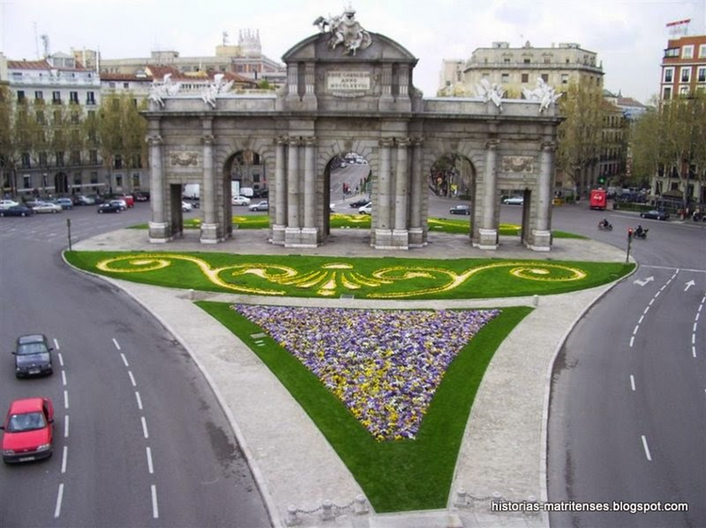
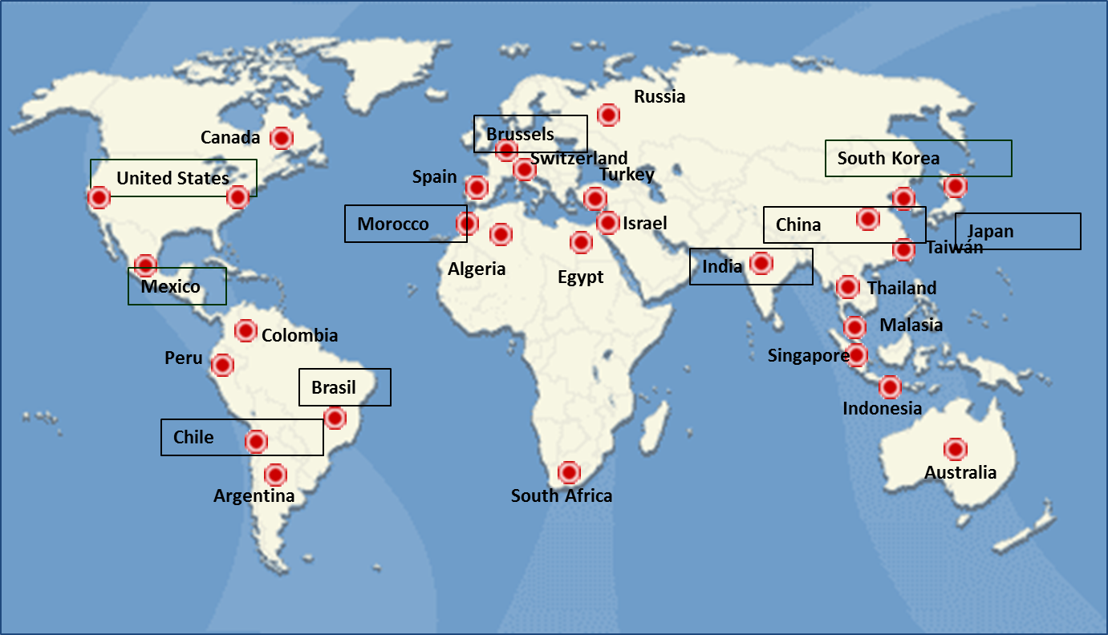
CDTI is the Spanish Eureka Office

Slide 8
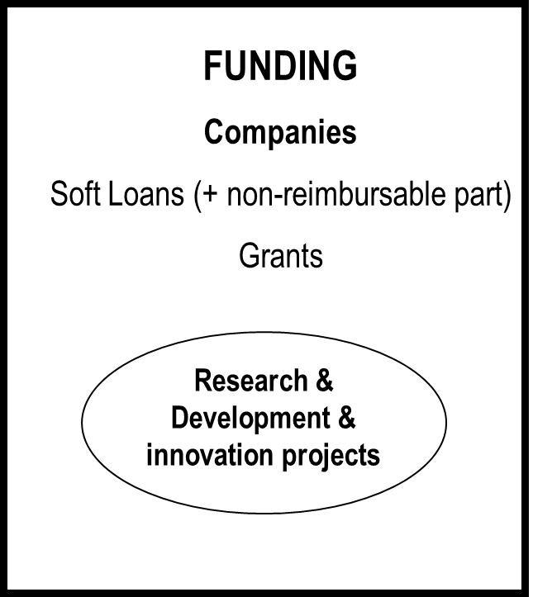
CDTI is the Spanish Eureka Office
Center for Industrial Technological Development
Created in 1977.
Public Entity (Ministry of Economy, Industry and Competitiveness, State Secretariat for R&D&i).
CDTI employs over 300 people. External network of offices or representatives present in 28 countries.
Enhance Spanish companies’ competitiveness and internationalization through innovation
CDTI´s funding is only for companies

Slide 9
What´s EUREKA?...… and what´s CDTI?
CDTI funding
SPAIN IN EUREKA

Slide 10
SMART
EUREKA
TOURISM
PLUS
ITEA 3
METALLURGY
EUROGIA
2020
SMART
CELTIC
PLUS
PENTA
EUROAGRI
EURIPIDES
UMBRELLAS
CLUSTERS
829 projects
Each instrument has its own funding tool
EUROSTARS
1927 projects
NETWORK
PROJECTS
4282 projects
E!nnoVest
Each entity is funded by its National Funding Body
EUREKA instruments
Over 40 countries
Notes:
Los países comprometen financiación en mayor o menor medida en cada iniciativa
Convocatoria abierta permanentemente pero fechas definidas para la aprobación
Posibilidad de llamadas conjuntas a nivel bilateral o multilateral

Slide 11
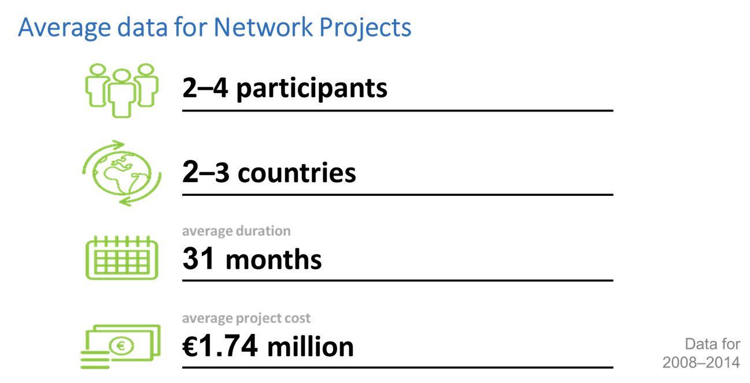
EUREKA NETWORK PROJECTS
A GOOD PROJECT:
Innovative result
Technological risk
Balanced (consortium, budget, working plan, impact)
PARTICIPANTS: COMPANIES (Large + SME)
Universities / Research Centers (subcontractors or self-funding)
DECENTRALIZED EVALUATION & FUNDING

Slide 12
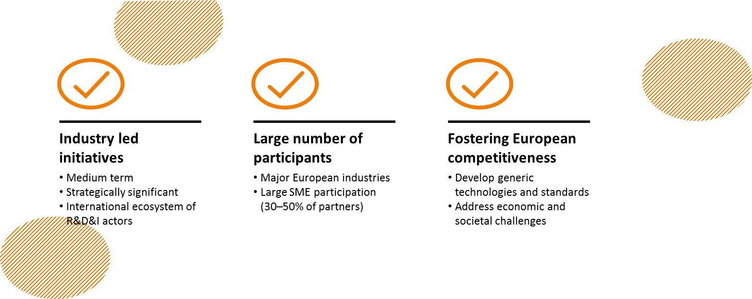
EUREKA Clusters
EVALUATION BY THE CLUSTER & DECENTRALIZED FUNDING
Advanced Manufacturing

Slide 13
CDTI Funding for Network Projects and Clusters Projects
FUNDING by Loans
Loans (euribor interest rate). Up to 75% of eligible budget
non- reimbursable part (33%)
INNOGLOBAL Grants
50% Small Companies, 40% Medium, 30% Large
Minimum budget 175.000 eur
Competitive!
FUNDING depends on the National Funding Rules!
Check with your NPC!

Slide 14
CDTI Funding for Network Projects and Clusters Projects
CONSORTIUM BUILDING
Submision National Funding application (loans)
LABELING
Submision International application
FUNDING DECISION
Contact NPCs
Feedback from
the
Eureka Office
LOANS
GRANTS
COMPETITIVE CALL
Submission once the
proposal is labeled

Slide 15
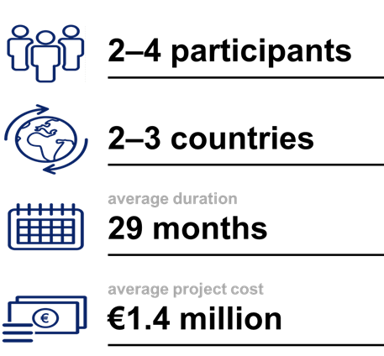
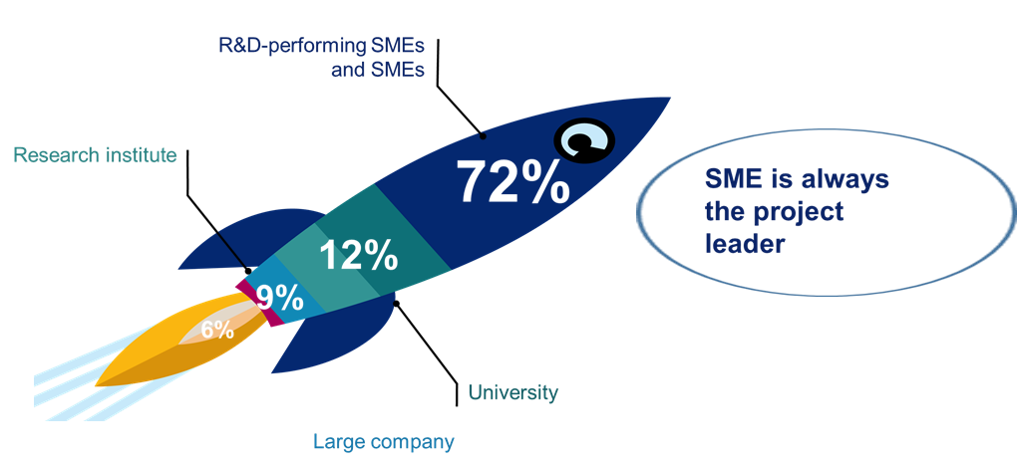
EUROSTARS
Centralized evaluation but decentralized funding
Notes:
Eurostars has been carefully developed to meet the specific needs of SMEs. It is dedicated to support the niche market of research-performing SMEs in their innovative R&D projects. 72% of the applicants are R&D-performing SMEs and other SMEs – the core focus for the programme. Other SMEs, research institutes, universities and large enterprises may also participate but the project leader must be an R&D-performing SME from a Eurostars country.

Slide 16
WHEN to submit a EUROSTARS proposal?
Cut Off 9: 1 March 2018
Cut Off 10: 13 September 2018
… 2 Cut Offs every year up to 2020

Slide 17
CDTI Funding for Eurostars
SPECIFIC CALL (Interempresas Internacional)
10 Mio Euros /year (2 CoDs) (11,8 Mio Euros in 2017)
GRANTS depending the size of the company:
SMALL COMPANIES: up to 60% of the eligible costs
MEDIUM COMPANIES: up to 50% of the eligible costs
LARGE ENTERPRISES: up to 40% of the eligible costs
FUNDING depends on the National Funding Rules!
Check with your NPC!

Slide 18
What´s EUREKA?...… and what´s CDTI?
CDTI funding
Some figures Spanish Chairmanship
SPAIN IN EUREKA

Slide 19
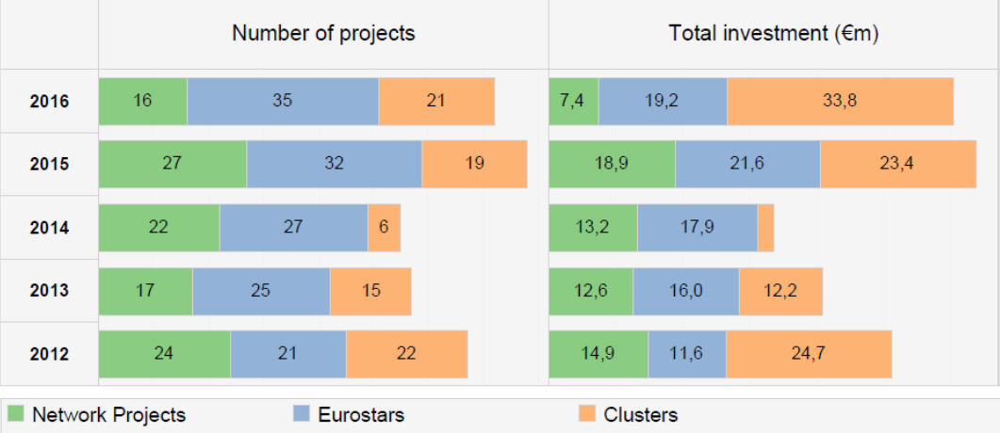
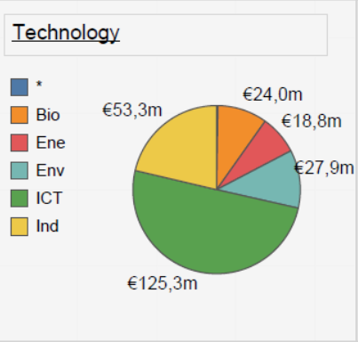
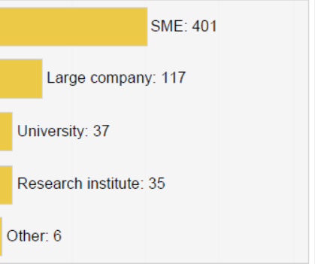
Spain in Eureka, some figures…
2012-2016: 1.528 projects
442 Network
882 eurostars
205 clusters

Slide 20
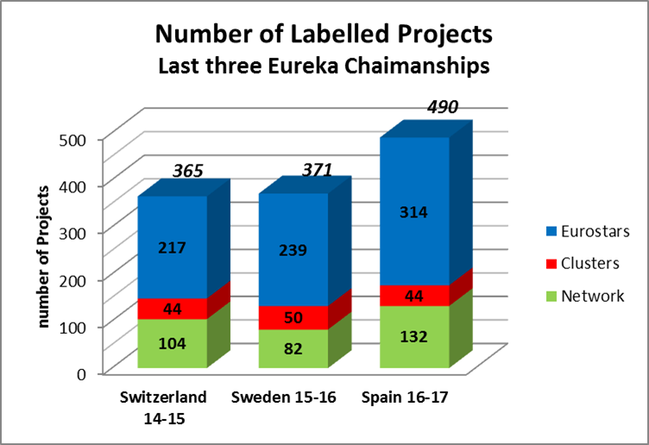
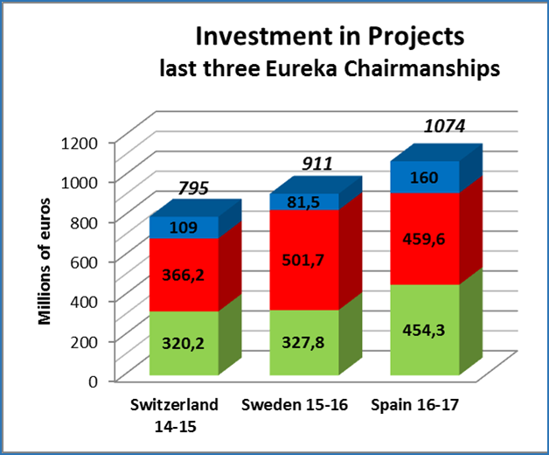
OBJECTIVES
SPANISH CHAIR FINAL REPORT. http://www.eurekanetwork.org/content/spanish-chair-final-report

Slide 21
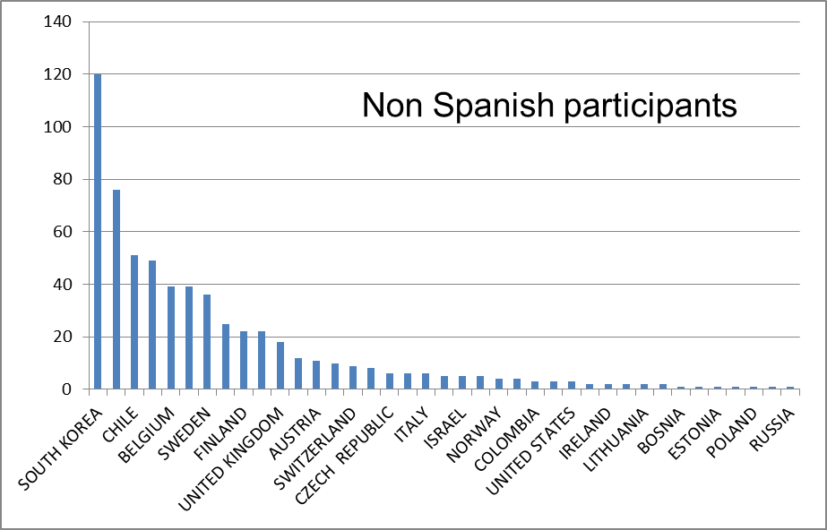
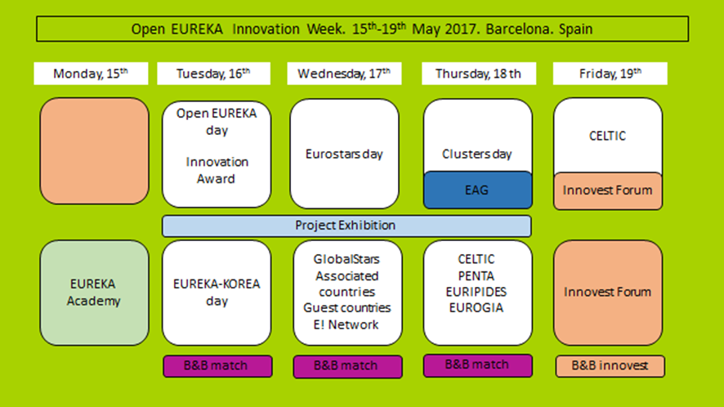
More than 1.000 attendees
More than 1.500 B2B meetings

Slide 22
More than 1.000 attendees
More than 1.500 B2B meetings

Slide 23
EUREKA INNOVATION WEEK in HELSINKI
21-25 MAYO 2018

Slide 24
EUREKA IMPACT ASSESSMENT – KEY RESULTS
For those companies that participate in Network or Cluster Projects in Eureka,
in comparison with non-Eureka companies:
Increase of the annual Turnover: 14%
Positive effect in the development of employment: 6%
Strengthened economic positioning
Entering of new markets
Improving market shares
Increasing exports
Increasing total staff and R&D dedicated staff
Increase of their competitiviteness
EUREKA IMPACT ASSESSMENT REPORT: http://www.eurekanetwork.org

Slide 25
Available instruments
BILATERAL CALL CZ-ES
Strategic areas
Partner searching
How to cooperate with Spanish companies

Slide 26
Available instruments
SMART
EUREKA
TOURISM
PLUS
ITEA 3
METALLURGY
EUROGIA
2020
CELTIC
PLUS
PENTA
EUROAGRI
EURIPIDES
UMBRELLAS
CLUSTERS
829 projects
EUROSTARS
1927 projects
NETWORK
PROJECTS
4282 projects
E!nnoVest
EUREKA instruments
Over 40 countries

Slide 27
Available instruments:
NETWORK PROJECTS:
BILATERAL CALL FOR JOINT PROJECTS
Deadline: January 25th
More flexible approach
Less competitive than Eurostars (higher success rate)
EUROSTARS:
Application March 2018
Main target: R&D performing SMEs
Centralized evaluation & decentralized funding
CLUSTERS:

Slide 28
Available instruments:

Slide 29
BILATERAL CALL… Let´s prepare a good proposal
The consortium …
At least: 2 INDEPENDENT companies from each country
Efective cooperation. 70/30 rule
SME & Large companies are elegible.
COMPLEMENTARITY
CONSORTIUM BUILDING: look at your value chain!
IN SPAIN: Universities and Research centers are welcome, as subcontractors
Deeply get knowledge of your partner
WELL BALANCED: budget, workplan, commercial and technological impact.

Slide 30
BILATERAL CALL… Let´s prepare a good proposal
… the R&D Project
Research & Development project
OBJECTIVES & DELIVERABLES: Clear and achievable
Close to the market
36 months
WELL BALANCE
The project should fit funding specification of each National Funding Body
The project should involve a technological risk
RESULT: Innovative product, process or service
The project should have an obvious advantage and added value resulting from the technological cooperation between the participants
Contact your NPC

Slide 31
Contact your National Contact Point !!!!
MEYS
Mr. Josef Martinec
Josef.martinec@msmt.cz
CDTI
inmaculada.cabrera@cdti.es
Ms. Inmaculada Cabrera

Slide 32
Some strategic areas of common interest
Automotive components
Smart Cities
Industry 4.0
Low carbon / alternative sources of energy
ICT equipment and software
EUREKA is Bottom-up

Slide 33
I´m interested, I´ve a project idea… but I don´t have a Spanish partner!
CDTI partner search service:
Database >20.000 Spanish clients
Support of regional nodes, Technological Platforms, research centers…
Send us an email: inmaculada.cabrera@cdti.es oscar.fernandez@cdti.es
EEN – Merlin system:
Eureka is a part of the EEN
… more details later on!

Slide 34
Conclusions

Slide 35
Don´t forget…
AN EUREKA/EUROSTARS CONSORTIUM: At least 1 Czech and 1 Spanish (independent) company
If R&D Performing SME: Better think about EUROSTARS !!
AN EUREKA PROJECT: R&D; Bottom up approach; civilian purpose; close to the market.
FUNDING: MEYS in Czech Republic & CDTI in Spain… CONTACT US
Inmaculada.cabrera@cdti.es
Josef.martinec@msmt.cz
Notes:
Los países comprometen financiación en mayor o menor medida en cada iniciativa
Convocatoria abierta permanentemente pero fechas definidas para la aprobación
Posibilidad de llamadas conjuntas a nivel bilateral o multilateral

Slide 36
To sum up…
EUREKA is an easy and fast framework to promote the international cooperation between companies in R&D projects, open to any civil sector with a Bottom-Up Approach
There are different instruments to cover the needs of the companies:
Network Projects: flexible, fast
Eurostars: focused on R&D Performing SMEs - competitive
Clusters: large, strategic initiatives leaded by industry.
it´s easy to cooperate!
Notes:
Los países comprometen financiación en mayor o menor medida en cada iniciativa
Convocatoria abierta permanentemente pero fechas definidas para la aprobación
Posibilidad de llamadas conjuntas a nivel bilateral o multilateral

Slide 37
Are you interested in cooperative R&D projects to reach the international market with innovative products?
then Eureka is the right instrument and Spain the right partner!

Slide 38
Thank you for your atention
Děkuji vám za pozornost

