Slide 1
EUREKA and Eurostars in Hungary
support services and funding, successful projects
Gergely Mészáros, EUREKA/Eurostars NPC
National Research, Development and Innovation (NRDI) Office
Prague, EUREKA and Eurostars Programme Conference, 07/12/2017

Slide 2
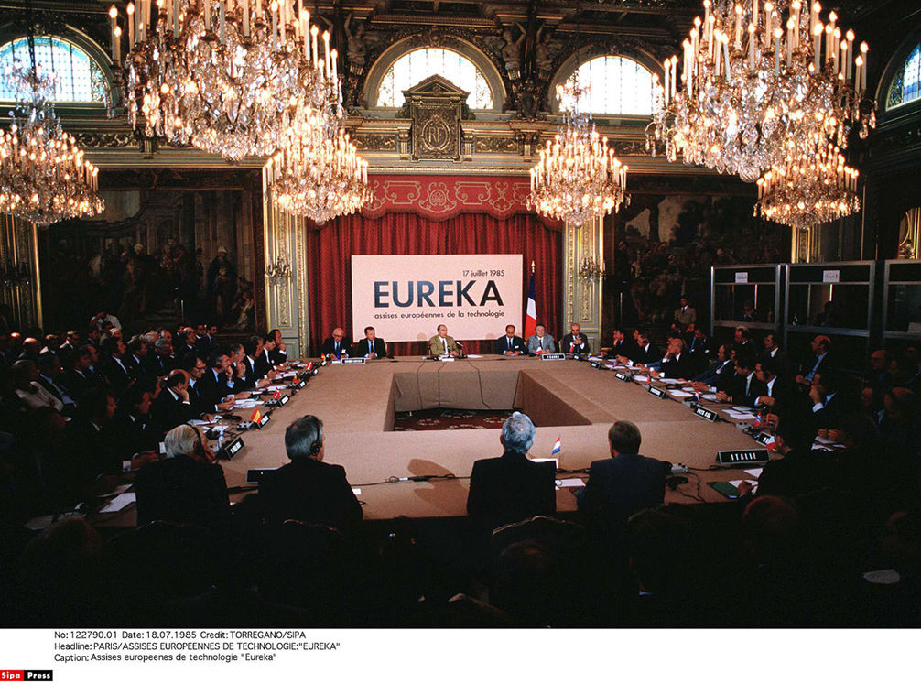
EUREKA Programme for Research and Innovation
Established in 1985
Intergovernmental network
Facilitator to international
RDI innovation
Facilitator to access to finance
for E! projects
Aim to raise the competitiveness
Of Europe globally
Notes:
EUREKA PROGRAMME FOR RESEARCH AND DEVELOPMENT ESTABLISHED IN 1985.

Slide 3
EUREKA in Hungary – 25 years from Tampere to Tampere
Joined in 1992
Pioneer in Central/Eastern Europe
Aim to enhance the collaboration
between companies and universities/RTOs
Leading platform for market-oriented
RDI collaboration

Slide 4
EUREKA in Hungary – Step by Step
E! Application Form
from the international partners
(in English) - - > E!No.Acr.
Confirmation from the HU NPC
to be eligible for funding in E! Hungary
(by email)
Apply for funding in the framework
of the Hungarian E! call (EUREKA_18)
2-3 months evaluation period and decision

Slide 5
EUREKA in Hungary - Timeline
EUREKA_18 will be published
in January 2018
First deadline: 28 March 2018
Evaluation period: April-June 2018
Labelling: July 2018
Expected start of the projects:
Autumn 2018
Second deadline: 28 September 2018

Slide 6
EUREKA in Hungary – Basic Rules I.
Funding Rate: Max. 80% for small enterprises, max. 75% for medium enterprises, max. 65% for large enterprises
Maximum Funding per Project: Max. cca. 225.000 €
Total budget available: cca. 1.900.000 € (Preliminary Information)

Slide 7
EUREKA in Hungary – Basic rules II.
Co-operation mandatory:
International corporation
Thematic restrictions: None
Term: max. 36 months
Application language: Hungarian
(EAF in English)
Duration until funding decision: From 8 to 12 weeks
Please note that the relevant Documents and Guidelines for the Hungarian EUREKA support programme expected to be available in January 2018.

Slide 8
EUREKA in Hungary – Additional information
Common budgetarian pot for Network and Cluster Projects
(EUREKA_18 is open for all E! Cluster activities)
Danube Region E! Call
(common call with Austria, Croatia, Czech Republic, Hungary and Romania):
http://www.eurekanetwork.org/content/danube-region-call-projects-2018
Bilateral call with Germany

Slide 9
EUREKA in Hungary – Success story
E! COMPONAT project (Germany – Hungary, 27 months, 620.000 euros): Development of high-performance polyurea composites for the construction sector, containing renewable natural components (http://www.eurekanetwork.org/content/new-resins-strengthen-pipe-repair-industry)

Slide 10
EUREKA in Hungary – Common projects with CZ
16 projects finished (169,07 million euros total budget – Czech and other international partners in the framework of cluster, umbrella and network applications)
E! FORMTES project (Czech Republic/Vodni Zdroje, a.s.– Hungary/Golder Associates Zrt., 37 months, 540.000 euros, still running): - Flood Risk Management Governance Through A Systematic Approach From Technical, Organizational And Socio-Economic Aspects

Slide 11
Eurostars in Hungary
Member from 2007 (Eurostars-1 Programme)
Renewal of the membership in 2014 (Eurostars-2 Programme)
Total funding commitment /year in Eurostars-2: 750.000€ (divided in 2 cut-offs)
31 approved projects in Eurostars 1&2 (as of November 30 2017)

Slide 12
Eurostars in Hungary – Step by Step I.
E* Application Form
from the international partners
(in English) - - > 2 international cut-offs/year
International evaluation period
and ranking list (14 weeks)
Commitment from the HU NPC
to be eligible for funding (only for projects
above threshold and until budget exhaustion)

Slide 13
Eurostars in Hungary – Step by Step II.
Apply for funding in the framework
of the Hungarian Eurostars call, NEMZ_18
(only for partners of the commited projects)
Single-stage formal evaluation
Official decision and contracting
(app. 6 months after the international cut-off deadline)

Slide 14
Eurostars in Hungary – Basic Rules I.
Funding Rate: Max. 80% for small enterprises, max. 75% for medium enterprises, max. 65% for large enterprises
Maximum Funding per Project: no limitation
Total budget available: 750.000€

Slide 15
Eurostars in Hungary – Basic rules II.
Co-operation mandatory:
International corporation
Thematic restrictions: None
Term: max. 36 months
Application language: English
(HU Eurostars Call in Hungarian)
Duration until funding decision: cca. 6 months after cut-off deadline
Please note that the relevant Documents and Guidelines for the Hungarian Eurostars support programme expected to be available in January 2018.

Slide 16
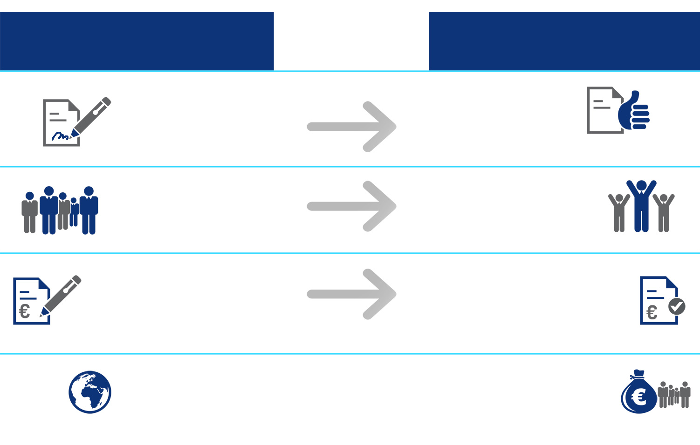
Eurostars-1 in Hungary in numbers
PROJECTS SUBMITTED
CUT-OFF 1-10
13,5 %
SUCCESS RATE
PROJECTS FUNDED
CUT-OFF 1-10
141
NUMBER OF APPLICATIONS
19
NUMBER OF APPROVED PROJECTS
182
NUMBER OF APPLICANTS
22
NUMBER OF APPLICANTS
55.7 MILLION €
TOTAL COSTS OF APPLICATIONS
5.6 MILLION €
TOTAL COSTS OF APPLICATIONS FUNDED
28
COUNTRIES INVOLVED
2.7 MILLION €
ESTIMATED PUBLIC FUNDING
© EUREKA Secretariat 2014

Slide 17
A typical Eurostars project in Hungary...
3 participants
2-3 countries
29 months
average duration
1.1 M€
average project cost
© EUREKA Secretariat 2014

Slide 18
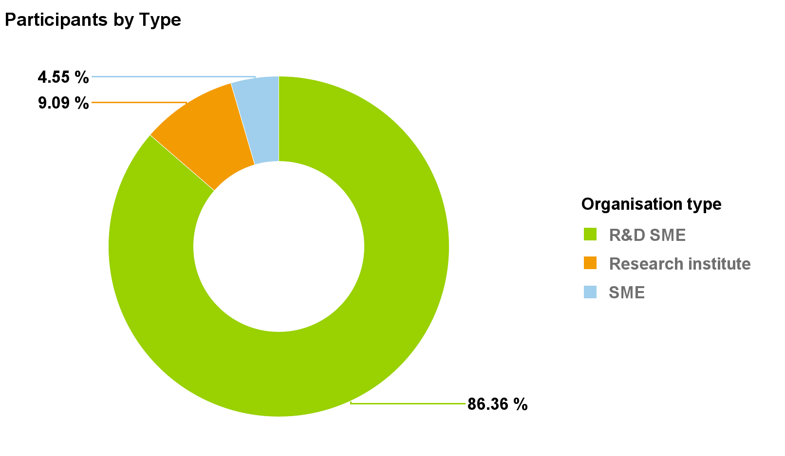
Participants profile in Hungary

Slide 19
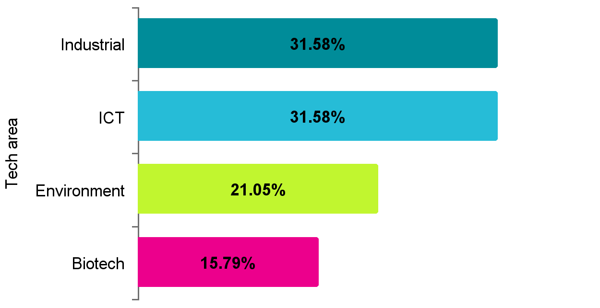
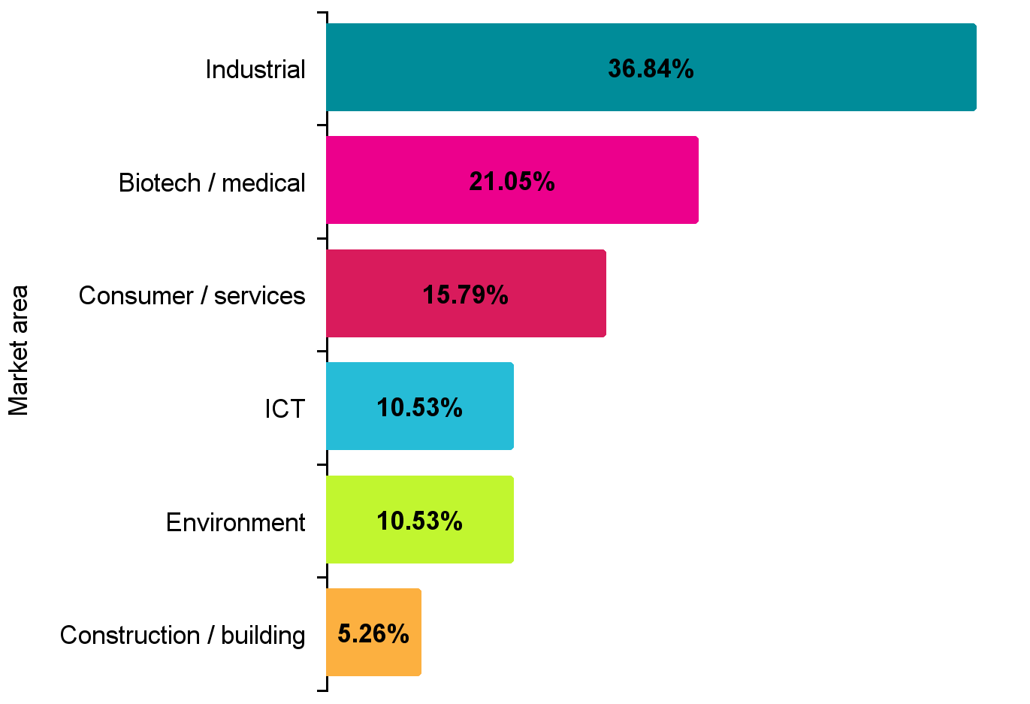
Technological and market area in Hungary

Slide 20
Project partners with Hungary

Slide 21
Eurostars in Hungary – A success story
ChiKEL project (UK – Hungary, 24 months, 671.131 euros): Interactive text mining platform for chemists, overcoming difficulties with extracting information about chemicals from scientific literature (https://www.eurostars-eureka.eu/content/text-mining-chemists)

Slide 22
CZ-HU: common success in Eurostars
E! 10316 – FIBRELAB project (Virtual Lab for Fibre Reinforced Concrete Design by Simulation Prototyping)
Cervenka Consulting s.r.o 74.1% 326 000€
JKP Static 25.9% 113 800€
Start Date : 2016-06-30 Duration : 36 months Total : 439 800€
3 CZ – HU project partnerships overall

Slide 23
EUROSTARS-2 in Hungary (on the rise)
77 Hungarian-related applications (12 funded)
244 applicants (27 funded)
Requested total costs: 70,5 million euros
(2,2 million euros from the committed Hungarian partners)
579 640 497 HUF (cca. 1,88 million euros) public funding
(Cut-offs 11-17)

Slide 24
EUREKA/Eurostars in Hungary – Support services
National Project Coordinator (NPC)
facilitates the setting up and running of a project
has responsible for project generator
supports international collaboration and project follow-up
promotes EUREKA and Eurostars nationally and transnationally:
http://nkfih.gov.hu/international/international-cooperation/eureka
https://www.eurostars-eureka.eu/countries/hungary
http://www.eurekanetwork.org/countries/hungary
provides advice during the whole lifecycle
of the project

Slide 25
THANK YOU FOR YOUR ATTENTION!
gergely.meszaros@nkfih.gov.hu
http://nkfih.gov.hu/english

