Slide 1
Health strengthening drinks
Local Fund "Science - Technological Park“
Minsk, Belarus
Svetlana Mikhnova

Slide 2
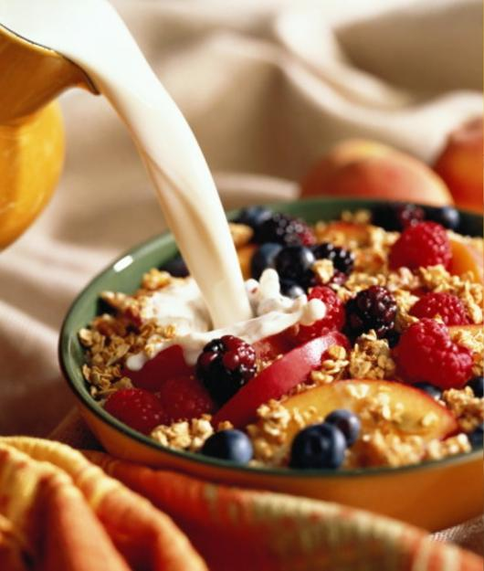
Functional Foods
Technopark BSU organizes and coordinates the work of various scientific and industrial organizations of Belarus in order to implement cooperation projects
Projects purpose: creating a line of food products with preventive properties

Slide 3
A deficiency of vitamins, minerals, dietary fibers, emotional stress, increased load => Chronic Fatigue Syndrome (CFS)
CFS (manifestation):
prolonged fatigue
muscular discomfort
fever
painful lymph nodes
arthralgia
loss of memory
depression

Slide 4
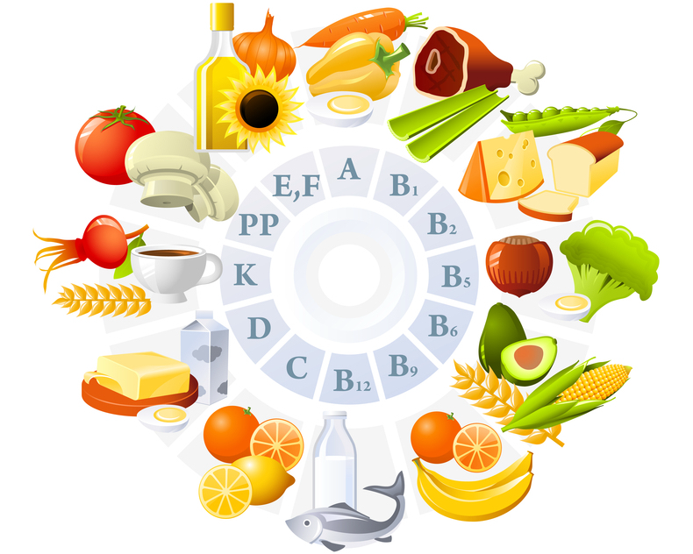
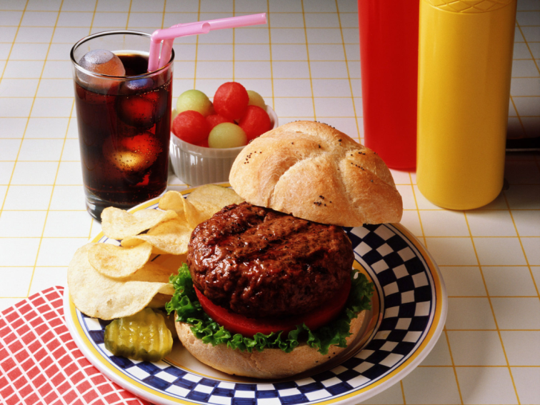
Diet of school children and students
A healthy diet:
Real situation:

Slide 5
Methods of CFS treatment
Drug therapy:
antimicrobial,
anti-inflamatory drugs,
antihistamine drugs,
antidepressant medication
etc.
Herbal preparations based on plant extracts:
supplements containing vitamins B6, B12, folic acid, ginseng extracts, Echinacea purpurea (USA)

Slide 6
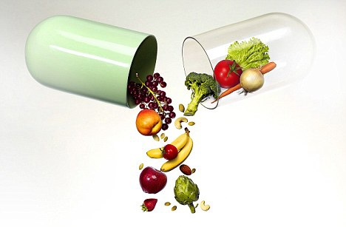
Exclusive role in human nutrition belongs to fruits and berries in fresh and processed form
easily digestible carbohydrates
organic acids
vitamins
flavor and aroma substances
minerals - potassium, calcium, magnesium, iron, phosphorus, etc.

Slide 7
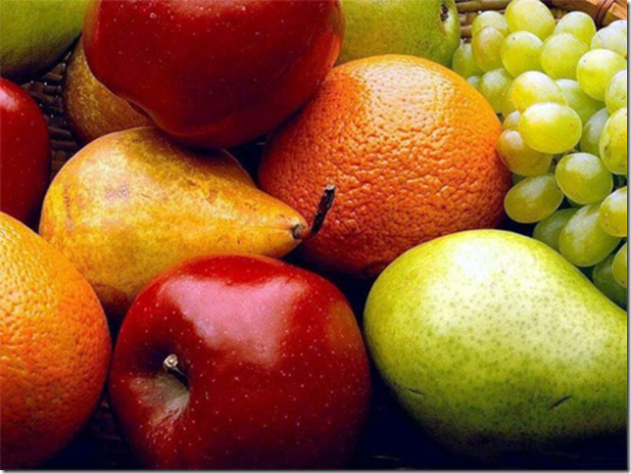
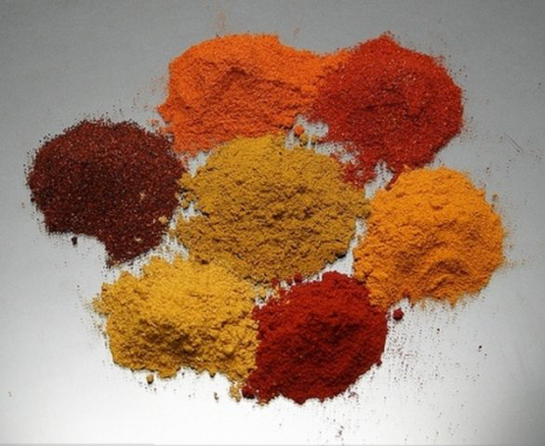
Functional significance of herbal powders is confirmed by the fact that they contain a set of materials adapted to the metabolic processes in the human body, and therefore cases of intolerance and allergic complications are
almost always excluded
Components of biologically active substances of herbal powders do not accumulate in the human body, and therefore their dose of exposure should not be regulated

Slide 8
Science and Technology Park of BSU
SPUP
Unitechprom BSU
Jointly develop:
COMPLEX HEALTH-IMPROVING MIXTURES
based on disintegrated plant material, containing in the structure vitamin-mineral supplements, amino acids, dietary fibers, making up for a deficit of vital components

Slide 9
the task of the republican program “Food for Children " for 2011-2015.
Development and research of science-based formulations combined series of functional drinks tonic properties, intended for children of secondary school age and students

Slide 10
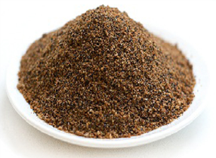
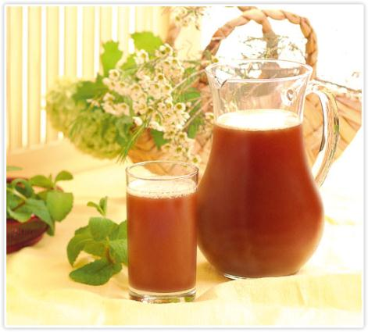
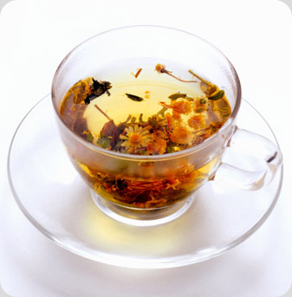
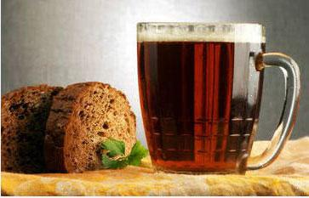
line of functional food in development:
1) dry teas for a single welding and catering establishments;
2) dry kvass drinks;
3) bottled tea drinks and kvass

Slide 11
Combinations of health-improving mixtures for tea and kvass drinks are based on natural, domestic vegetable raw materials and processed fruit and berries
powder of dried apple and / or apple pomace,
powder of dried beetroots,
powder of dried carrots,
cinnamon,
nutmeg
cumin,
ginger,
cloves,
oregano,
sweet grass,
peppermint,
melissa,
black currant (berries)
blueberry (berries)
daisy flowers,
black tea,
green tea
hibiscus tea
etc.

Slide 12
health-improving mixtures also contain:
- rye malt (fermented),
- vitamins B (B6, folic acid), vitamin PP;
- organic acids (ascorbic acid, succinic acid, citric acid);
- insoluble dietary fibers (inulin, pectin);
- vital trace elements;
- isotonic solutions.

Slide 13
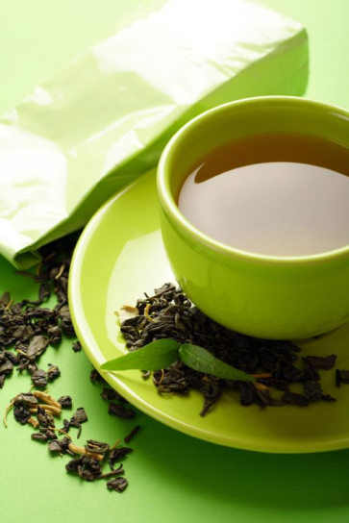
Health-improving drinks of combined structure – preventive products of polyfunctional profile
- With significant biological values and familiar organoleptic characteristics;
- With a high concentration of natural vitamin-mineral complexes, and other biologically active substances;
- Adapted to the needs of the growing organism in conditions of deficiency of macro- and micronutrients;
- With a maximum degree of assimilation.

Slide 14
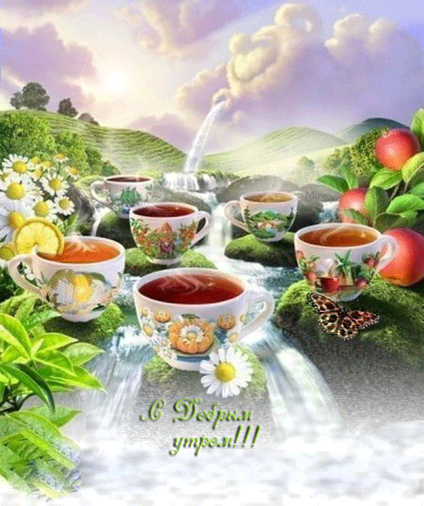
,
Important properties of health-improving drinks:
Consuming such drinks leads to:
no dependency syndrome
no withdrawal
These drinks:
are involved in the regulation and improving the protective biological mechanisms of the body
increase endurance
protect against certain diseases or warn them
improve psychological and psychosomatic condition

Slide 15
Products of this kind are necessary for many groups of population:
especially for school children and students,
for people engaged in heavy mental or physical work, requiring a lot of energy,
as well as for those living in ecologically unfavorable regions.

Slide 16
Thank You For Your Attention!!!

