Slide 1
Inovace a technologie v rozvoji regionů
doprovodný program Stavebních veletrhů Brno 2016
Program Eurostars
– evropský nástroj pro inovace
Svatopluk Halada
Asociace inovačního podnikání ČR, z.s.

Slide 2
Inovace a technologie v rozvoji regionů
doprovodný program Stavebních veletrhů Brno 2016
Regions
define and implement strategies and policy instruments to build on their strengths
are seeking to promote their economic development increasingly through support to innovation

Slide 3
Inovace a technologie v rozvoji regionů
doprovodný program Stavebních veletrhů Brno 2016
Regional development is
a broad term but can be seen as a general effort to reduce regional disparities by supporting economic activities in regions

Slide 4
Inovace a technologie v rozvoji regionů
doprovodný program Stavebních veletrhů Brno 2016
Did you know?
about 10% of regions account for over half of R&D in the OECD area
the top 10% of OECD regions generate on average about 280 patents per million inhabitants, while 40% produce fewer than 20
in OECD regions, innovation policy portfolios include traditional supply side, demand side and networking instruments, as well as experimental measures
Source: OECD Regional Database

Slide 5
Inovace a technologie v rozvoji regionů
doprovodný program Stavebních veletrhů Brno 2016
i/ Networking instruments: four levels
local
regional
national
Europenan (global)
ii/ Networking instruments: different types of R&D tools
Branch and regional clusters
Science and Technology Parks
R&D vouchers (local, regional)
R&D programmes (national, European)
(usually involves some public funding)

Slide 6
Inovace a technologie v rozvoji regionů
doprovodný program Stavebních veletrhů Brno 2016
European multilateral R&D programmes
networking instruments
supporting innovation across regions & countries
EU Framework programme
since 1984; Horizon 2020 (1994-2020)
COST
since 1971
EUREKA programme
since 1985
Eurostars programme
since 2008; Eurostars-2 (2014-2020)

Slide 7
Inovace a technologie v rozvoji regionů
doprovodný program Stavebních veletrhů Brno 2016
Eurostars programme
supporting innovation across regions & countries

Slide 8

Eurostars is…
Joint programme between EUREKA and EU
Dedicated to R&D-performing SMEs
Market-oriented
Bottom-up
International cooperation

Slide 9
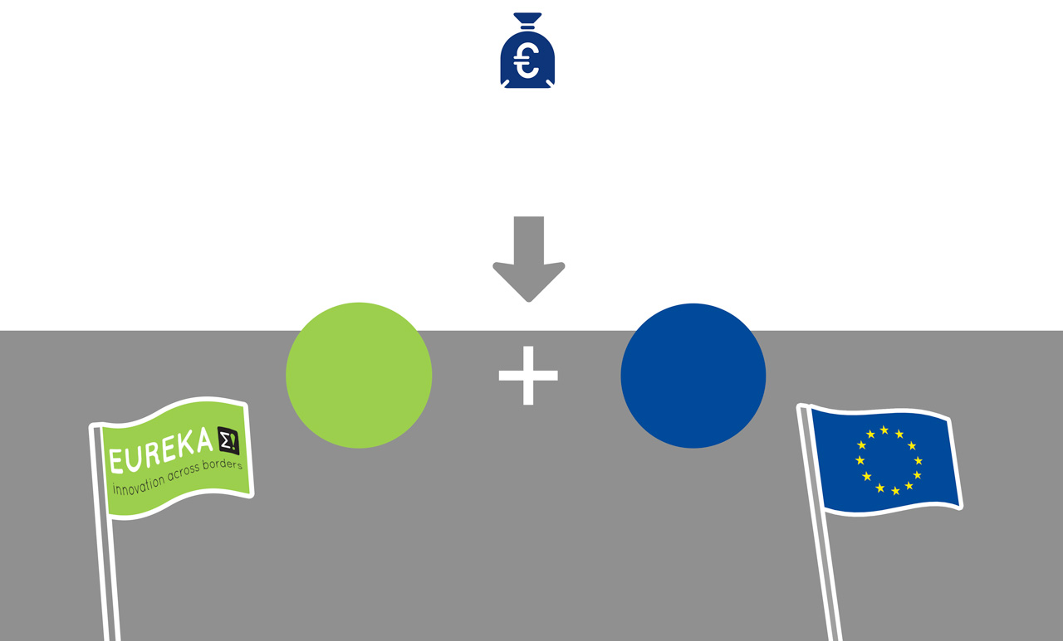
Eurostars under Horizon 2020
1.148 BILLION
EUROSTARS TOTAL PUBLIC BUDGET 2014-2020
75%
25%
EUROSTARS
COUNTRIES
CONTRIBUTION
EU
CONTRIBUTION
© EUREKA Secretariat 2014

Slide 10
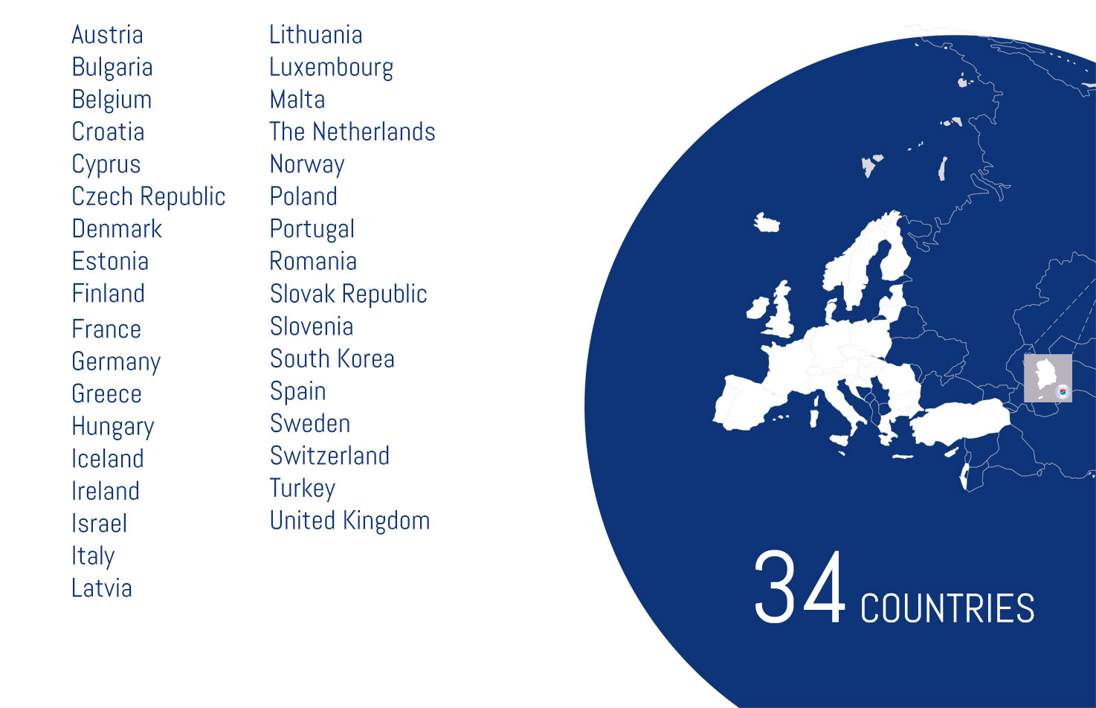
Eurostars countries
© EUREKA Secretariat 2014

Slide 11
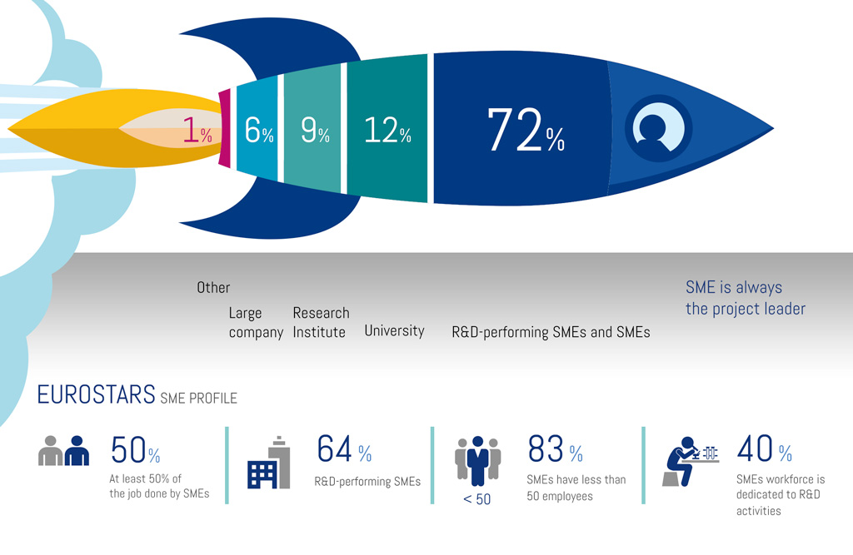
SMEs in the driving seat
University
© EUREKA Secretariat 2014

Slide 12
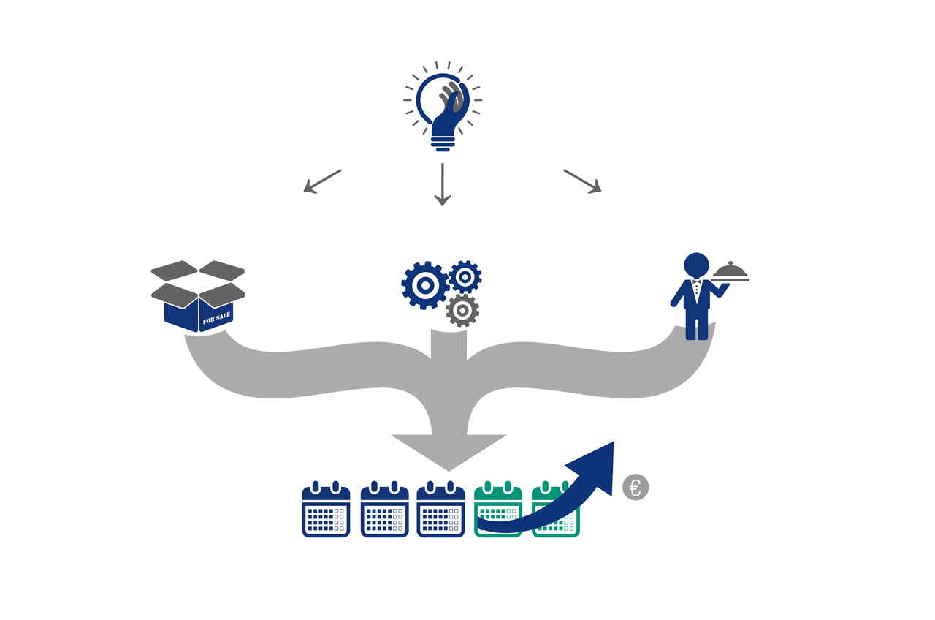
Market-oriented
INNOVATIVE
PRODUCT
PROCESS
SERVICE
YEAR1
YEAR2
YEAR3
YEAR4
YEAR5
Market introduction is foreseen within 2 years after project completion

Slide 13
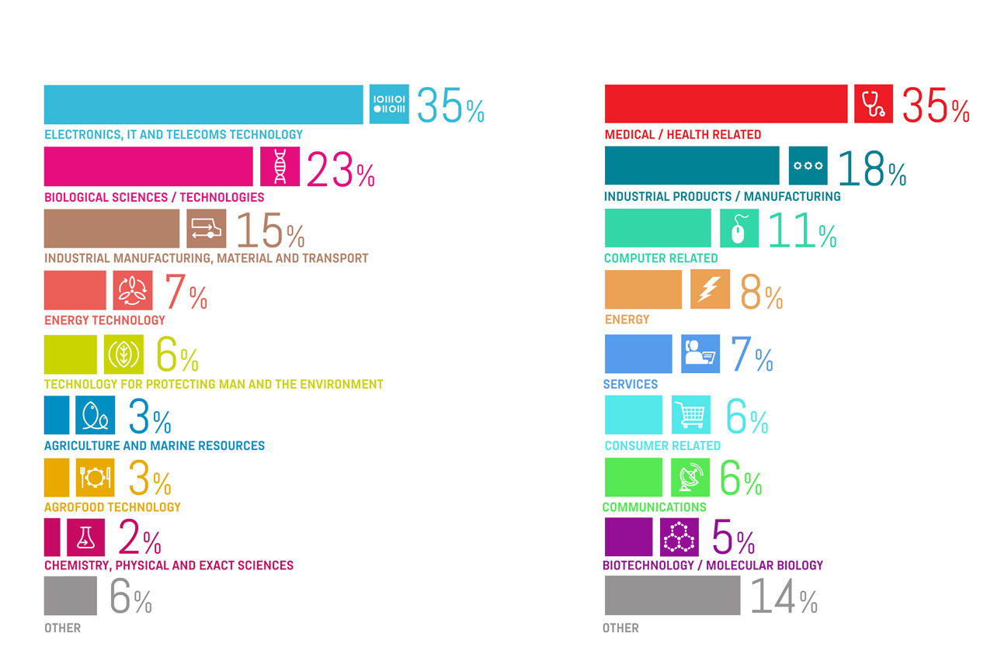
Bottom-up approach
TECHNOLOGICAL AREAS
MARKET AREAS
PROJECTS SUBMITTED
PROJECTS SUBMITTED
© EUREKA Secretariat 2014

Slide 14

Eligibility
Project leader is an R&D-performing SME from a Eurostars country
At least
2 participants
Autonomous entities
Legal entities
from at least
2 Eurostars countries
SMEs are in the driving seat
International balance
Project duration is max. 3 years
Market introduction within 2 years

Slide 15

A typical Eurostars project is...
3-4 participants
2-3 countries
29 months
average duration
1.4 M€
average project cost
© EUREKA Secretariat 2014

Slide 16
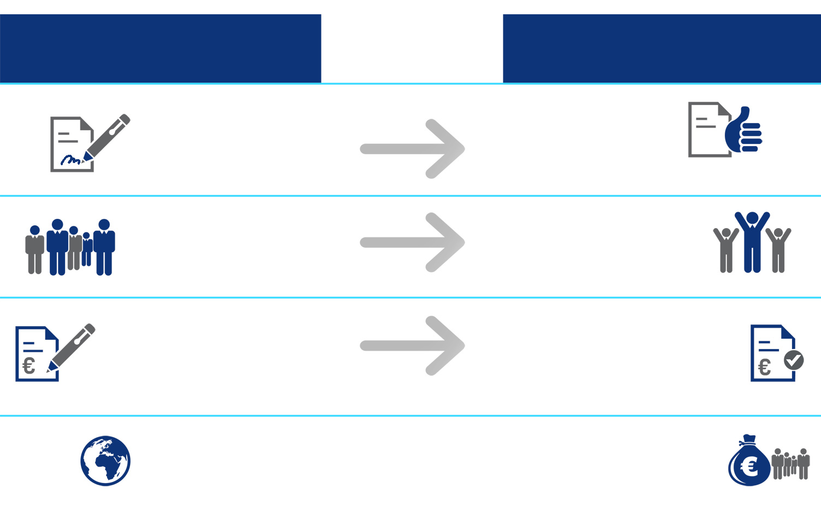
Eurostars in numbers
23%
SUCCESS RATE
PROJECTS SUBMITTED
CUT-OFF 1-10
PROJECTS FUNDED
CUT-OFF 1-10
3,548
NUMBER OF APPLICATIONS
783
NUMBER OF APPROVED PROJECTS
11,733
NUMBER OF APPLICANTS
2,600
NUMBER OF APPLICANTS
4.9 BILLION €
TOTAL COSTS OF APPLICATIONS
1.1 BILLION €
TOTAL COSTS OF APPLICATIONS FUNDED
47
COUNTRIES INVOLVED
472 MILLION €
ESTIMATED PUBLIC FUNDING

Slide 17
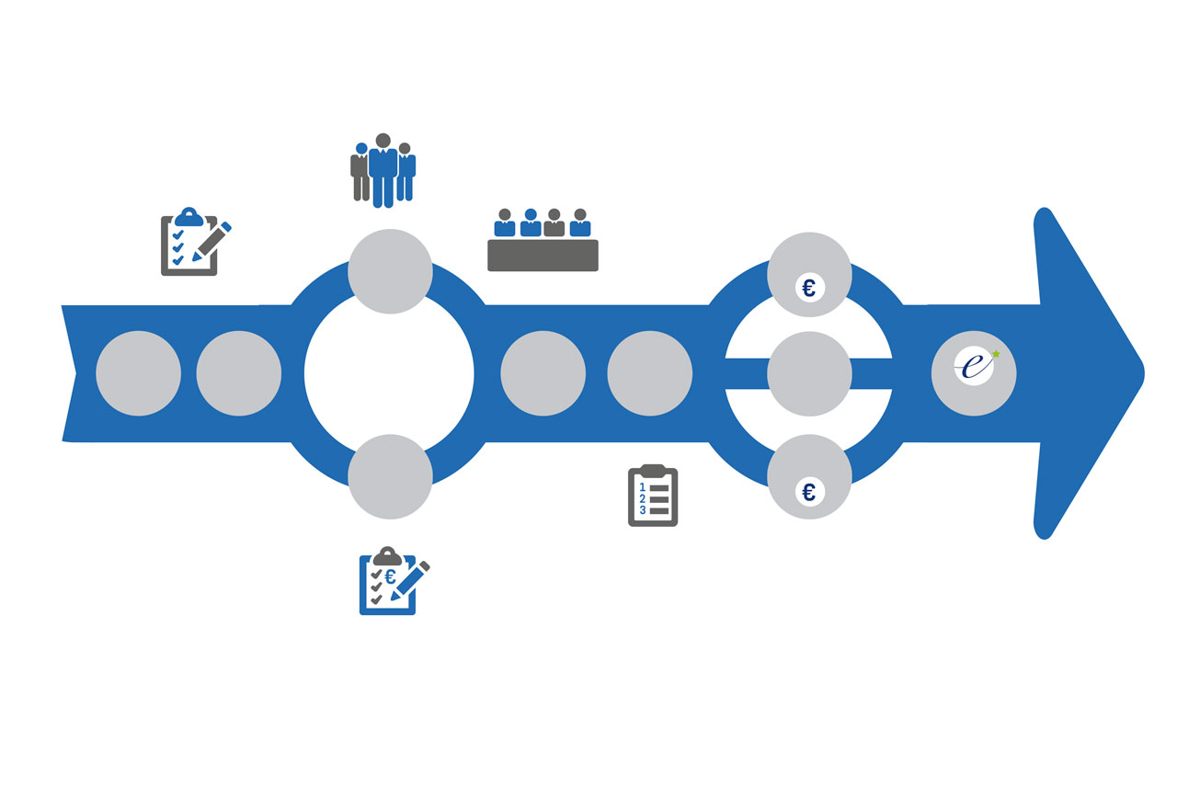
Evaluation
SECURED FUNDING
EXPERT
EVALUATION
PUBLIC
COMPLETE-NESS
CHECK
ELIGIBILITY
CHECK
PANEL
EVALUATION
+RANKING
RANKING
LIST
CONSORTIUM
AGREEMENT
(CA)
MONITORING
APPLICATION SUBMITTED
START
FINANCIAL
VIABILITY
CHECK
PRIVATE
EUROSTARS
SECURED FUNDING

Slide 18

Evaluation criteria
QUALITY AND EFFICIENCY
OF THE IMPLENTATION
BASIC ASSESSMENT
EXCELLENCE
INNOVATION AND R&D
IMPACT
MARKET &
COMMERCIALISATION
Quality of the consortium
Added value through co-operation
Realistic and clearly defined Project management & planning
Reasonable cost structure
Degree of Innovation
New applied knowledge
Level of Technical Challenge
Technological achievability & Risk
Market size
Market access and risk
Competitive advantage
Clear and realistic commercialisation plans
Time to market

Slide 19
Evaluation timing
Time-to-contract is within 4 to 7 months

Slide 20
Eurostars programme in the Czech Republic.
Eurostars 2014-2020
available budget 1 M€/year
national funding rules
responsibility of MEYS
Typ organizace | Maximální % financování způsobilých nákladů | Maximální výše podpory (v tis. Kč/rok/projekt) | Doplňující informace
Malý a střední podnik | 50% | 4 000 | 10% bonus pro MSP s vlastním V&V, který je hlavním řešitelem projektu.
Velký podnik | 50% | 4 000
Vysoká škola | 50% | 4 000 | Společná účast s podnikatelským subjektem je doporučena.
Výzkumná organizace | 50% | 4 000 | Společná účast s podnikatelským subjektem je doporučena.

Slide 21
Eurostars programme in Czech regions
Eurostars 2008-2013: 38 projects
SČK | JČK | PLN | JMK | VYS | MSK | ÚSK | OLK | KHK | PUK | ZLK | KVK | LIK | PRA
3 | 0 | 4 | 7 | 0 | 3 | 0 | 0 | 0 | 6 | 1 | 1 | 1 | 12
LAS ENV BIO | --- | MAT ICT INF (2) | ENV TRA (2) INF ROB BIO (2) | --- | ROB INF BIO | --- | --- | --- | BIO (3) ENV (3) | ENV | ROB | MAT | INF (3) ICT (3) ROB (2) MAT ENE ENVCOM

Slide 22

Eurostars success story
Project 4231 INSIDER
Eurostars backed high-tech firm helps taxi drivers
As the trend for geo-location applications is rapidly expanding, Correlation Systems developed RAE is a device which adapts the principle of data-mining to GPS and helps taxi companies to work more efficiently. The additional turnover expected in two years is of 10 M€. 8 new jobs were created in the company during the course of the project.
Countries: Israel, Hungary, CZECH REPUBLIC
Cost: 0.5 M€
Duration: 12 Months

Slide 23

Inovace a technologie v rozvoji regionů doprovodný program Stavebních veletrhů Brno 2016
www.eurostars-eureka.eu
THANKS FOR YOUR KIND ATTENTION
Svatopluk Halada
AIE CR
halada@aipcr.cz

