Slide 1
Vladimir Nedzilko
Support for innovation activities by the Belarusian Innovation Fund

Slide 2
Belinfund: Setting up
The task of establishing a new funding mechanism and developing of an integrated system of measures to encourage and support domestic producers has been was solved partly through the setting up of a national fund for special purposes – the Belarusian Innovation Fund. Its main goal is to provide a support for innovative productions.
Belinfund was founded in 1998, by the Regulation of the Council of Ministers of the Republic of Belarus №1739 to strengthen the public support for innovation. It is a public non-profit organization.
The activities are carried out in the form of financial support to implementation of innovative projects, analysis of the results of S&T programs, selection of best and promising developments. BelInFund presents just one of the forms of the public support to innovation activities in Belarus.

Slide 3
Belinfund: the order of providing a financial support
Innovative Project (IP)
50%
Belinfund
Result
50%
IP Executer
IP State Customer
Repayment

Slide 4
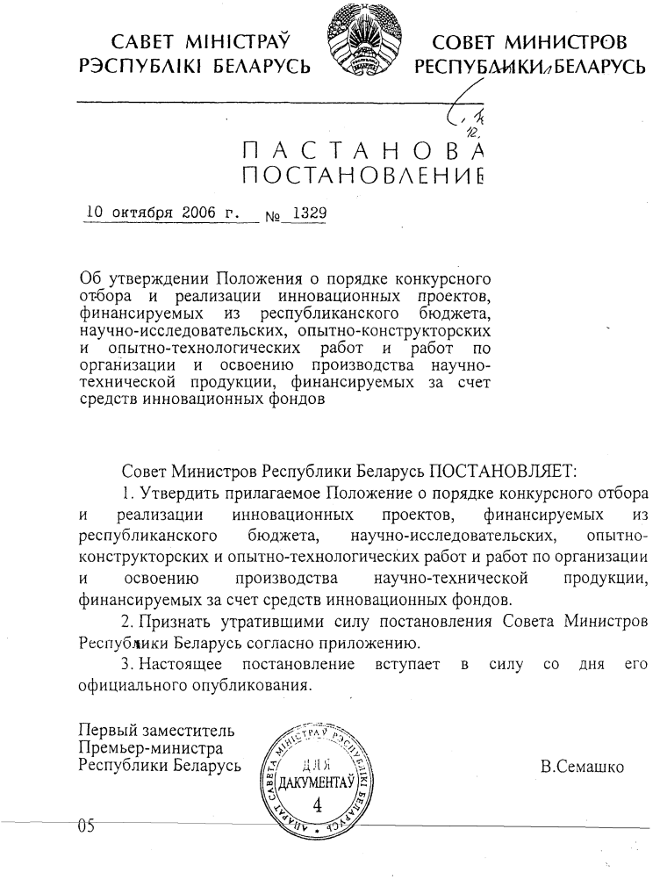
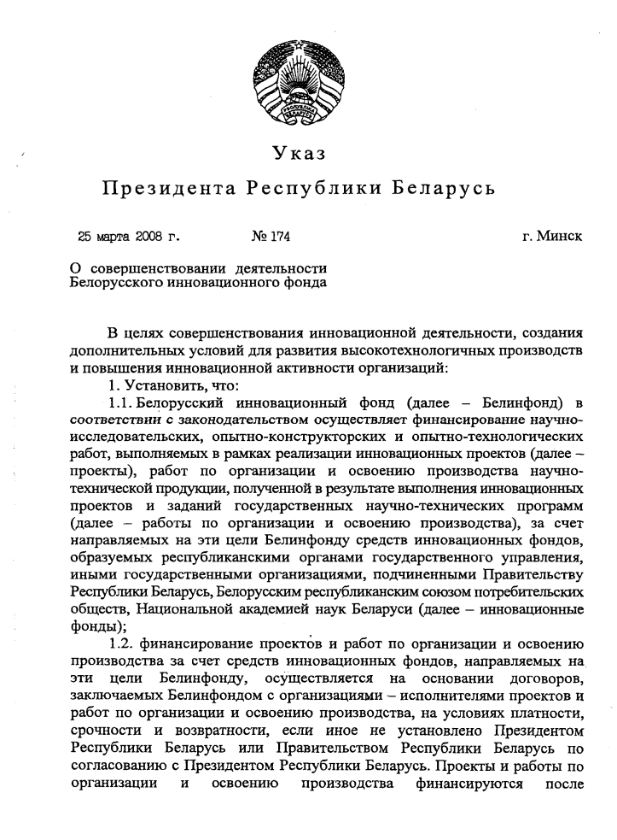
Transition towards activities on mastering of the innovative productions
The transition period lasted from 2005 to 2008

Slide 5
The new financing scheme
STATE PROGRAMS, INNOVATIVE PROJECTS
Research
Development
Setting up and mastering of a production
Belinfund
State budget
Repayment
Innovation funds (3%)
Other sources

Slide 6
Public Corporation “Gorizont”
Setting up a production of house-hold technique “Gorizont-midea”
Funding:
14 494,0 mln BYR Belinfund
7 111,0 mln BYR Innovation Fund of the Ministry of Industry
6 617,0 mln BYR Public Corporation “Gorizont”
A new production of house-hold technique has been set up (46 varieties of microwave ovens). More than 360 thous ovens for over 47.0 bln BYR produced. 269 new jobs created. The ratio of Belinfund spendings to the is 1:3.2 (for 2008-2010).

Slide 7
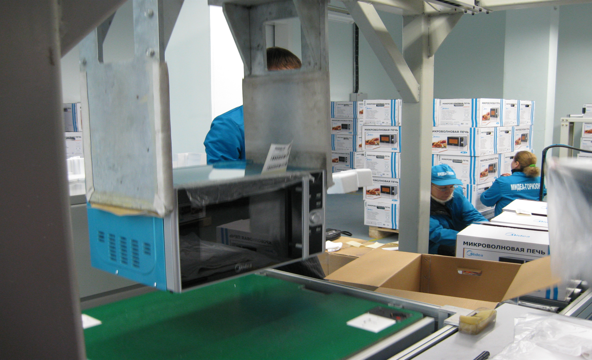
Production of house-hold technique
“Gorizont-midea” (microwave ovens)

Slide 8
Scientific Production Republican Unitary Enterprise “UNIHIMPROM BSU”
Developing a technology for producing the biodiesel from rapeseed oil, creating an installation for producing the biofuels
Funding-
996.0 mln BYR Belinfund
1002.0 mln BYR own funds
By the end of 2009, the Public Corporation “Grodno-Azot" produced 10.14 thous tons of fatty acids methyl esters and 247.73 thous tons of mixed fuel using the installation.
At the installation at the Public Corpporation “Khimvolokno”, Mogilev developed by "Unihimprom BSU” 8.8 thous tons of fatty acids methyl esters and 264.0 thous tons of mixed fuel have been produced.

Slide 9
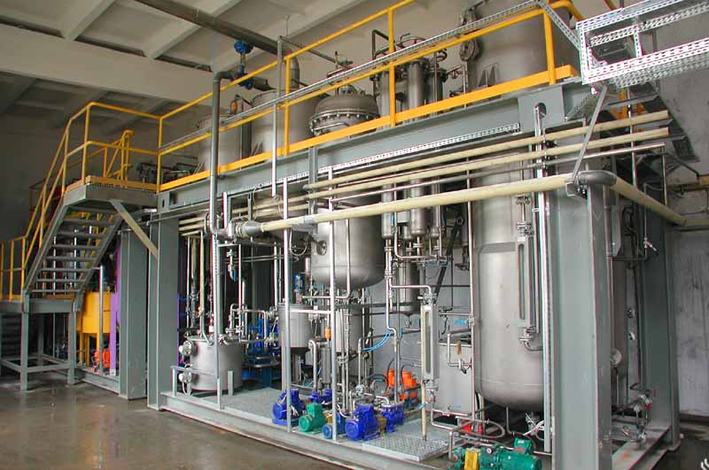
Installation for industrial producing of biofuels from rapeseed oil (PC “Grodno-Azot”, Grodno)

Slide 10
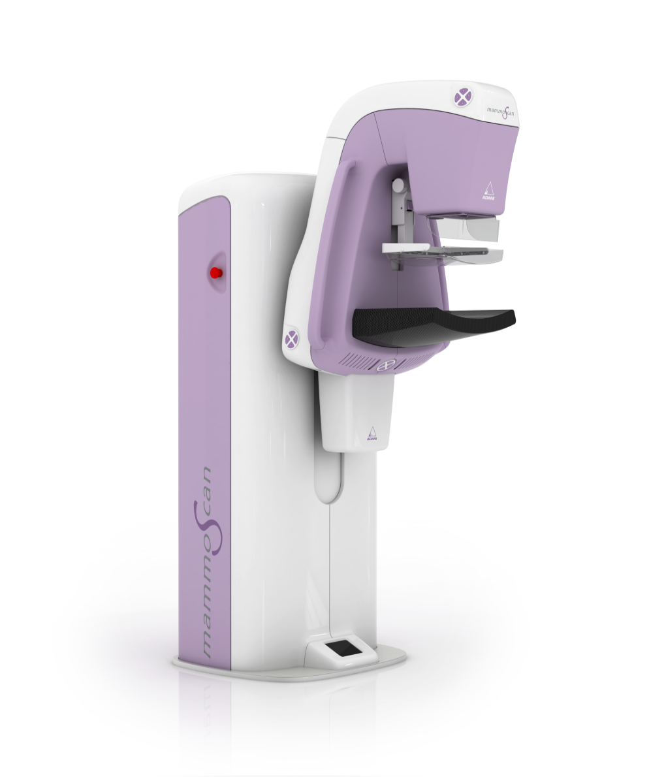
Scientific Production Private Unitary Enterprise “ADANI”, Minsk
Digital x-ray mammography

Slide 11
Advantages of being supported by Belinfund
Time frame to use the financial support – up to 5 years
Repayment is calculated using 0,5 refinancing rate
Delay in the payment of interest and principal debt;
The absence of mortgage and insurance

Slide 12
Challenges
Lack of opportunities to support high-risk projects;
Complicated system of selection and approval of innovative projects; state customer is obligatory;
Belinfund is not able to form its own funds;
The only source of funding is the budget

Slide 13
Decree № 252 of 17.05.2010 “On amendments and changes in some decrees of the President of the Republic of Belarus”
The Decree regulates the activities of venture capital organizations, gives a definition of a "venture project" and "venture capital organization”, establishes a system of incentives to encourage venture businesses.
The developing of initial stages of the venture investment system in Belarus is carried out by Belinfund. It has been entrusted additionally with a function of a venture capital firm in terms of supporting financially the venture projects.
Belinfund supports the venture projects in high technology and knowledge-intensive industries. Projects must have a high economic and innovation efficiency and sustainable competitive advantages ensured by the techno-economic parameters of the created products and technologies compared to the analogues.

Slide 14
Venture capital financial mechanism
The difference between Belinfund and the existing world practice is that the financing of the projects is not shared but is carried out in the form of a discounted loan.
Belinfund may buy shares of an innovative company as a collateral for a loan.
After the repayment of a loan, an innovative company can buy the embodied shares from BelInFund.

Slide 15
Venture financing scheme
Providing the budget funds on the basis of repayment
Buying the shares of an innovative company (using the other sources than the budget)

Slide 16
Criteria for selection of venture projects
Demand for the product in the internal and/or external market;
Protected intellectual property rights;
Possibility for commercialization and the start of a production and sales (services) in a relatively short time-not more than 3 years;
Possibility to split the financing of a project into stages and define intervals in which decision about the further funding is to be taken;
Potential target market should be 300 bln BYR/year (ar 100 mln USD/Year)
Opportunity to exit a project (to sell Belinfund’s /venture capital organization’s shares in the innovative company) in a few years;
IRR no less than 40% during the funding period;
The investment/project - up to 5 bln BYR (ar 1.5 mln USD);
Organizational and manufacturing capacity and qualified team for the needs of a project;
The co-funding of a project from own funds and other sources for at least 50% of the project cost.

Slide 17
Tax benefits within venture projects implementation
Venture organizations and Belinfund are exempted from payment of interest tax on the income they have received from innovative organizations as an interest generated from the use of venture funds, as well as dividends and similar income.
Obtained additional funds will be used for financing the new venture capital projects, creating the new innovative companies and other activities.

Slide 18
Venture Company “EurAsEC Center of Innovative Technologies”,
Limited Liability Corporation
Russian Venture Company, Russia
National Agency for Technological Development, Kazakhstan
Belinfund, Belarus

Slide 19
Venture Company “EurAsEC Center of Innovative Technologies”, Limited Liability Corporation (VC CIT EurAsEC)
Rules for setting up:
Registration of VC CIT EurAsEC in Russian jurisdiction
Management: Board of Directors, Management Board of the company;
Contributions by Parties - 30.0 mln RUB each;
Definition of Parties’ shares and face value;
Development of internal documents:
  final version of the Charter;
  regulations on the Board of Directors and Investment Committee;
  other

Slide 20
Thank you for attention!
Belarusian Innovation Fund
31A-403 Khoruzhej str.
220002 Minsk
BELARUS
Tel/fax +375 17 2931781
e-mail: belinfund@mail.ru

