Slide 1

Main directions of innovation policy development in the Republic of Belarus
State Committee for Science and Technology
Prague, December 2, 2014

Slide 2
The program of social and economic development of the Republic of Belarus for 2011 - 2015 years
Main goals:
welfare improvement
and improvement of living conditions by 2 ways :
improvement of socio-economic relations,
2. innovative development and increase of competitiveness of the national economy
The main problems
creating conditions for the development of human potential on the basis of the creation of a full family, real income growth and improvement the comfort of living of the population, improvement of health and enhancement of the quality of education and culture of citizens
creating favorable conditions for implementation of entrepreneurial initiative of business entities, including the strengthening of motivation to work effectively and increase of employees' responsibility for the results and the quality of their work
improving the structure of the economy based on priority development of resource-saving, high-tech industries with high added value and advanced types of services
2

Slide 3
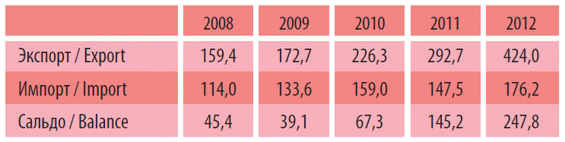
The Republic of Belarus in the international rankings
Knowledge index (from 146 counties all over the world)
2010 г. – 52nd position, 2012 г. – 45th position
Education index of the World Bank (from 145 counties)
2012 г. – 33rd position
The Global Innovation Index (index of «Higher Education» )
2013 г. – 17th position in the world,
Bloomberg innovation index
«Level of higher education» 2nd position in the world
«Growth of new knowledge and technologies» 54th position
«Creation of new knowledge» 27th position
Intellectual property, mln. Dollars. (US)
3

Slide 4
Main planned values of innovation development till 2030
 | 2015 | 2020 | 2025 | 2030
Percentage of innovation-active organizations, % | 22,5 | 25,0 | 27,5 | 30,0
Percentage of innovative products, % | 20,0 | 21,5 | 23,0 | 25,0
Number of researchers per 10 th. people of population | 20 | 22 | 25 | 30
Percentage of non-budgetary sources in the internal costs of research and development, % | 55 | 60 | 65 | 70
Salary in economic activity "Research and development" as a% of the nominal monthly wages of employees of the Republic of Belarus | 130 | 150 | 175 | 200
The number of patents for inventions, industrial designs, plant varieties, created by scientists of the Republic of Belarus, per 100,000 inhabitants | 9,4 | 12,1 | 16,6 | 22,8
Gross domestic expenditure on investigations as % of GDP | 1,0 | 1,5 | 2,0 | 2,5
4

Slide 5
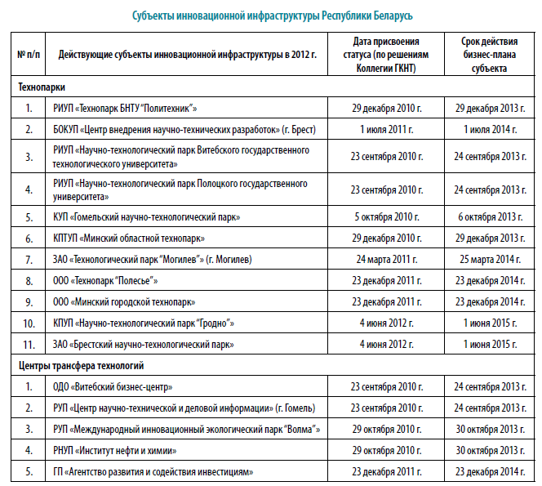
Innovation Infrastructure of the Republic of Belarus
12 technoparks
(the 1st one oped in 2014 г. – about it further),
5 technology transfer centers,
scientific production (theoretical and practical) centers and holdings in the structure of the National Academy of Sciences of Belarus and the sectoral ministries.
5

Slide 6
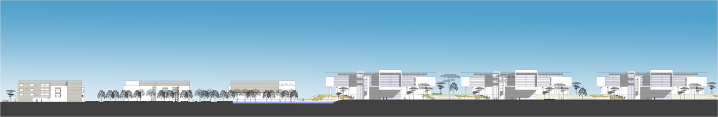

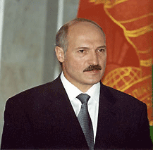
High-Tech Park
Decree of the President of the Republic of Belarus 22.09.2005 № 12 “About the High-Tech Park"
What is High-Tech Park?
Special legal regime aimed at carrying out development of modern information technology and software, increasing their exports, as well as bringing in this area domestic and foreign investment.

Slide 7
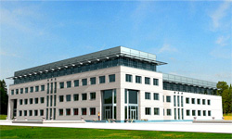
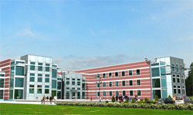
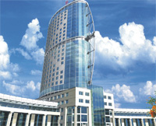
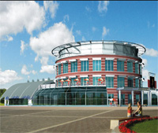
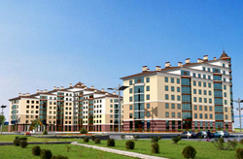
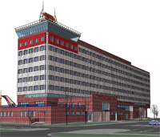
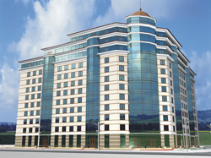
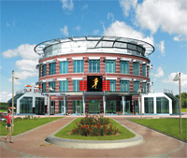
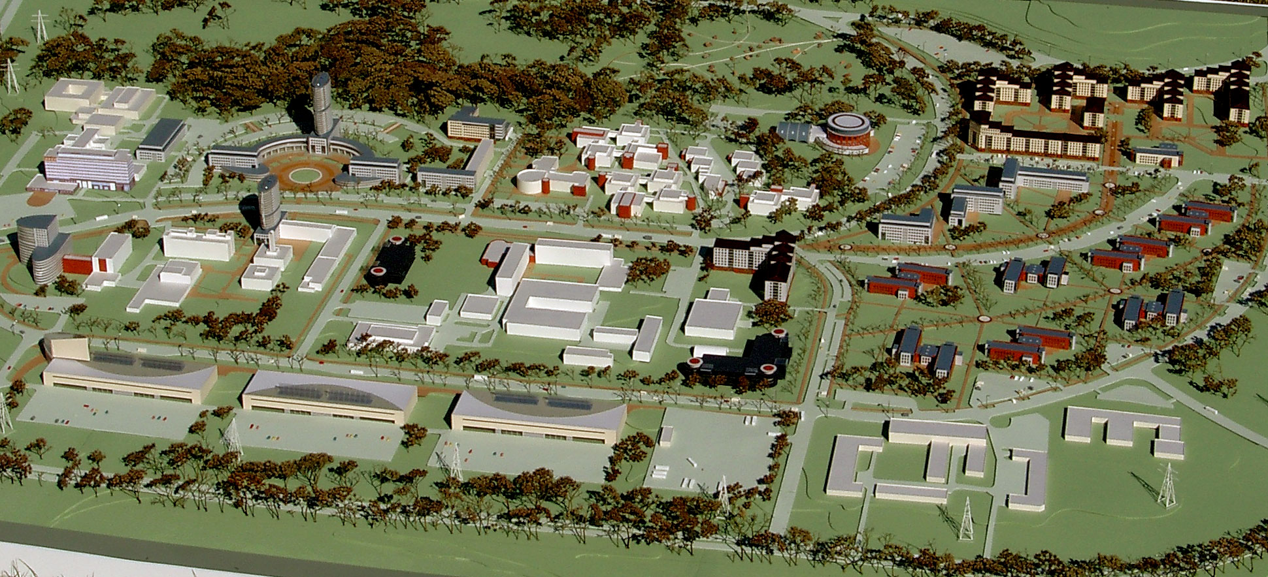

Slide 8





High-Tech Park
HIGH-TECH PARK
46 COMPANIES
4 BUSINESS-PROJECTS
> 5000 EMPLOYEES

Slide 9

(12th technopark)
Benefits
"Great Stone"
Chinese-Belarusian industrial park
Preferential taxation «10+10»: exemption from all corporate taxes for 10 years from the date of registration as a resident of the park and the reduction of existing tax rates by 50% over the next 10 years of activity in the park.
Exemption from payment of park residents of customs duties and VAT when importing goods to Belarus to be used for the implementation of investment projects in the park
Customs regime free customs zone, which gives the right to import goods (raw materials), provided for their further processing and export to countries outside the Customs Union, without payment of customs duties (duties, VAT, excise duties).
individual income tax rate is fixed at 9%, which is 25% less than the nationwide one.
Exemption of Park resident for 5 years from the year of occurrence of gross profit from income tax on accrued dividends to the founders.
The tax rate on income of foreign organizations without permanent representation in Belarus royalty, the process, is 5% (3 times less than the nationwide).
9

Slide 10
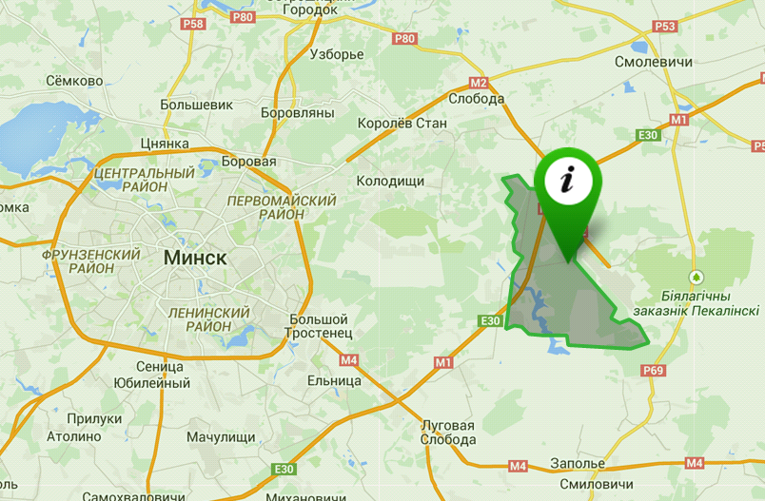
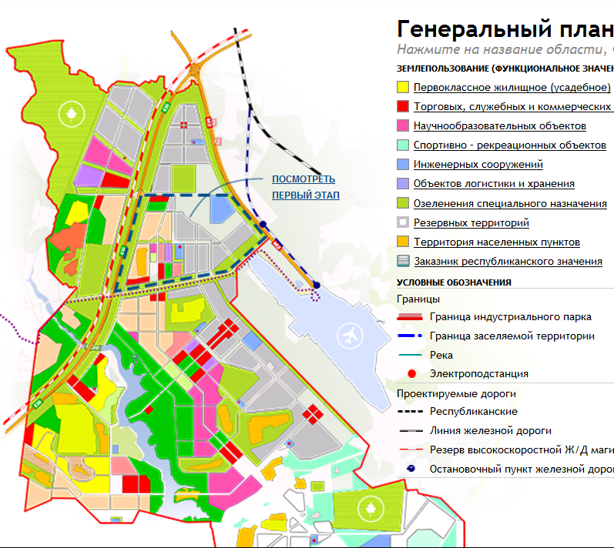


The land in the park investor can get in use (lease) for up to 99 years or to buy into private ownership.
15 км.
25 км.
The proximity to the city of Minsk (the capital's population - 1.9 million. pers., Students - 450 thousand. pers.) and the capital's satellite cities Smolevichy (population - 15 thousand. pers., 15 km from the park) promotes maintenance of the park with professional staff.
10

Slide 11
Priorities of scientific and technological development
In Belarus there are the priority directions of scientific and technical activities, the development of which the state pays the most attention:
energy and energy efficiency
agro-technology and production
industrial and construction technology and production
medicine, medical equipment and technology, pharmacy
chemical technology, nanotechnology and biotechnology
information and communication technology and aerospace
new materials
environmental management, resource conservation and protection from emergency situations
defense capability and national security
11

Slide 12
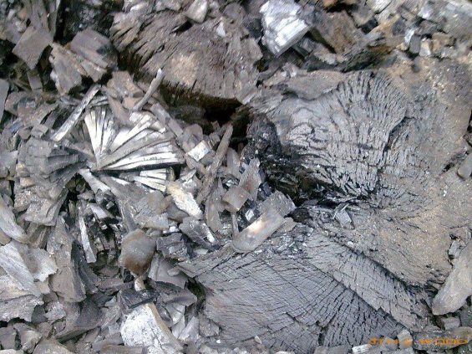

Creation of new and improvement of existing highly promising high-tech sectors
wood chemistry;
genetic engineering, chemical and pharmaceutical and biotechnology;
robotics and automation, nanotechnology;
Information and Communication Technologies
12
Notes:
12

Slide 13
Additional systemic measures to promote research and innovation policy of the Republic of Belarus
The development of a unified state system of scientific and technical expertise of innovative projects.
Creation of a system of venture financing of scientific developments.
Creation and maintenance of the state system of the commercialization of results of scientific and technological activities.
Allocation of funds on a fundamentally new (breakthrough) research and development up to 20 per cent of the national budget.
When the projects are included in the State Programme of Innovative Development of the Republic of Belarus, funding for their implementation is provided from the innovation funds through lending by JSC "Development Bank of the Republic of Belarus" and the Belarusian Innovation Fund.
13

Slide 14
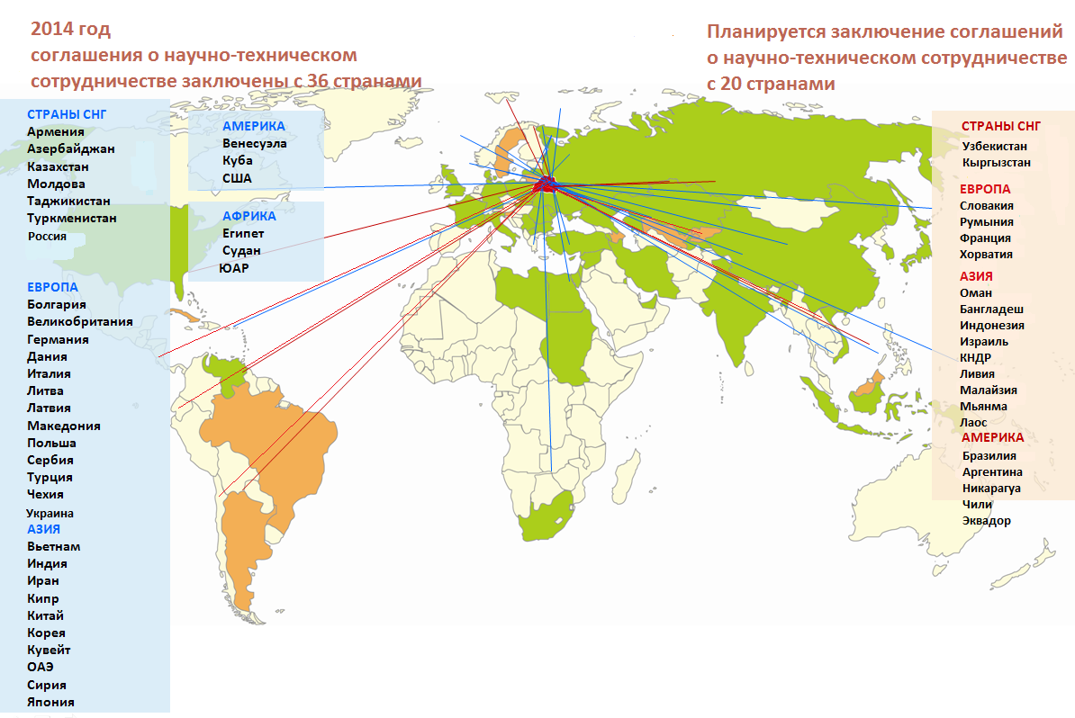
International cooperation
С 20 странами действуют комиссии по научно-техническому сотрудничеству
14

Slide 15
Thank you for your attention!
15

